Slide 1


INTERNSHIP REVIEW
‹#›
Abhishek Deshpande Machine Learning / Data Science Intern
Div: A
Roll No: ECE 116

Slide 2
‹#›
EPIDEMIC NETWORK SIMULATION
Simulating epidemics based on various Network Models

Slide 3


EPIDEMIC NETWORK SIMULATION
‹#›
Collaboration between MIT WPU, CU Boulder, VIT and Algo Asylum.
Development of meaningful simulations
Population Modelling
Notes:
-introducing more meaning to the networks.
-random interaction with a certain power law distribution attached to it.

Slide 4
MODELLING POPULATION
‹#›
Individuals are represented by nodes
Interaction between individuals can be represented by edges
Clusters of Nodes can represent communities
Edge weight affects the probability of transmission
Notes:
The nodes can belong to different classes and clusters.
‘’’’
Classes could be age groups, genders, professions etc. The clusters could be based on the location of people.
‘’’’’
Individuals interact with each other ==edges in the graph.
‘’’’

Slide 5
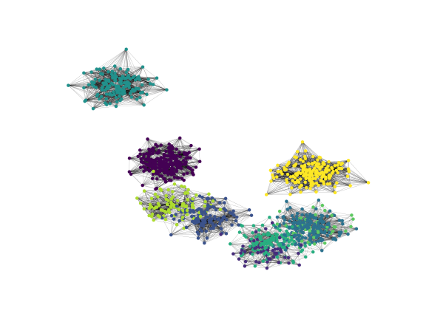
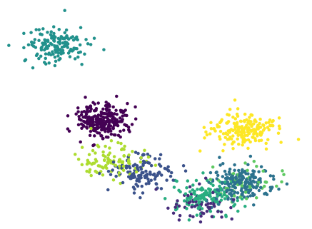
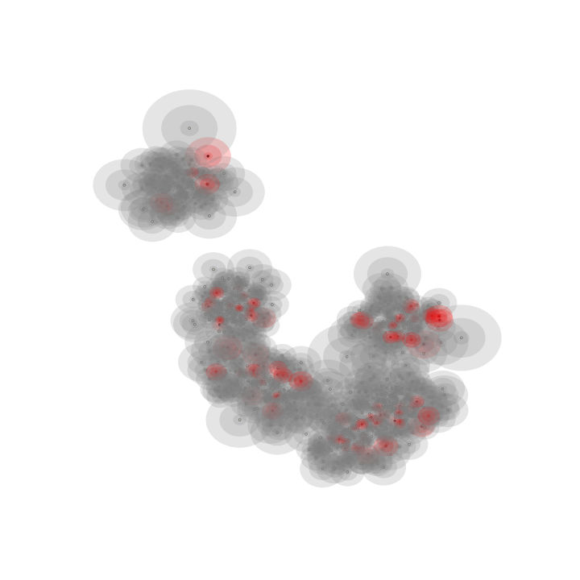
UMAP
‹#›
Uniform Manifold Approximation and Projection
Topological Data Analysis & Manifold Learning
Clustering and Unsupervised Learning
Network Generation
https://umap-learn.readthedocs.io/en/latest/basic_usage.html

Slide 6
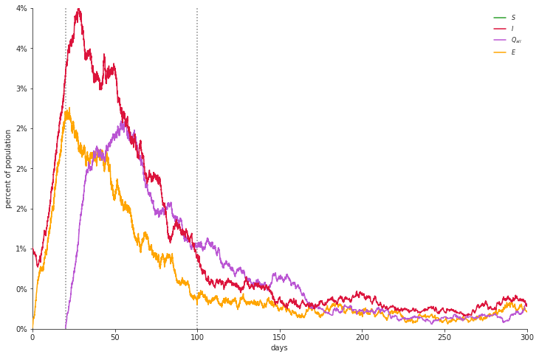
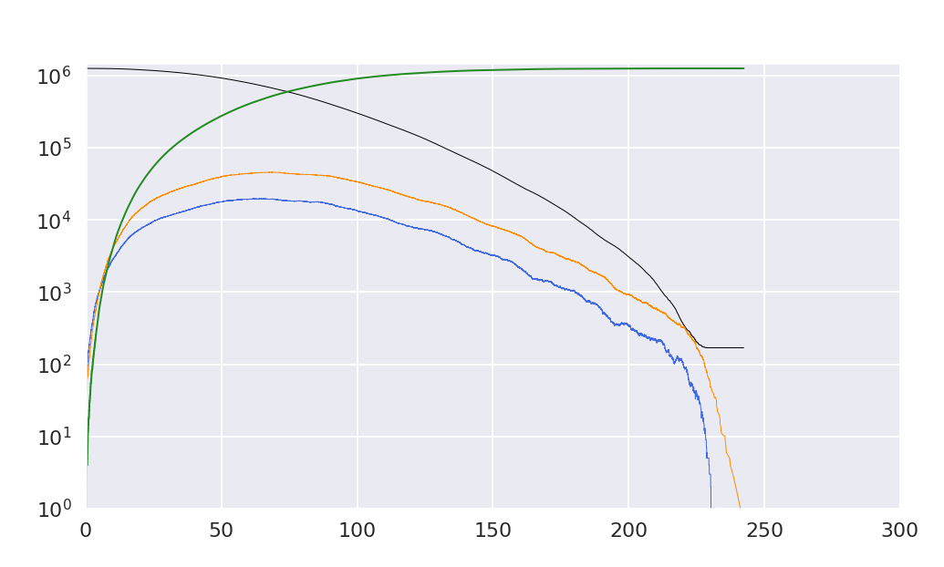
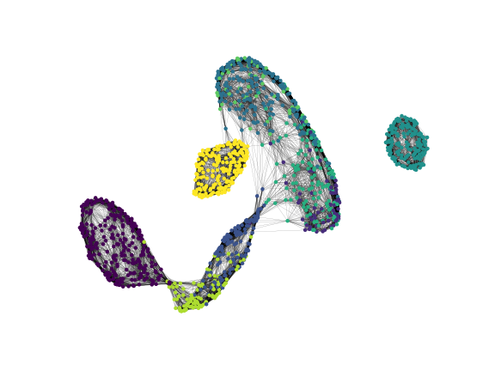

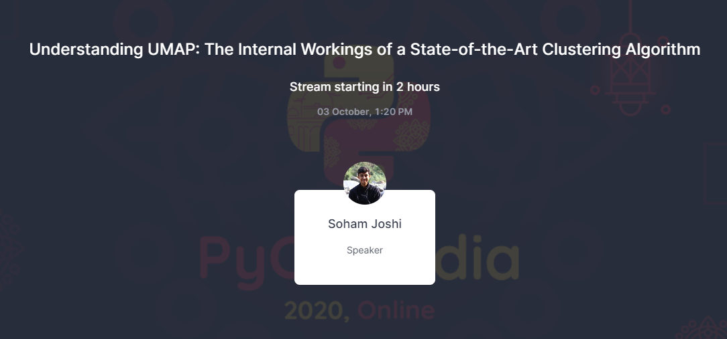
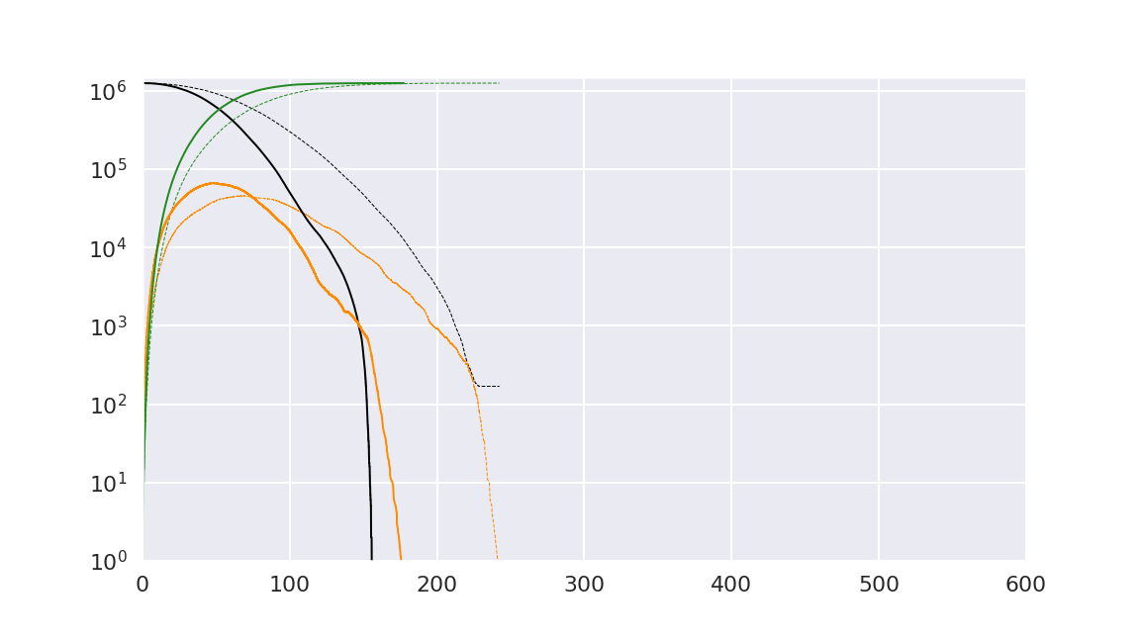
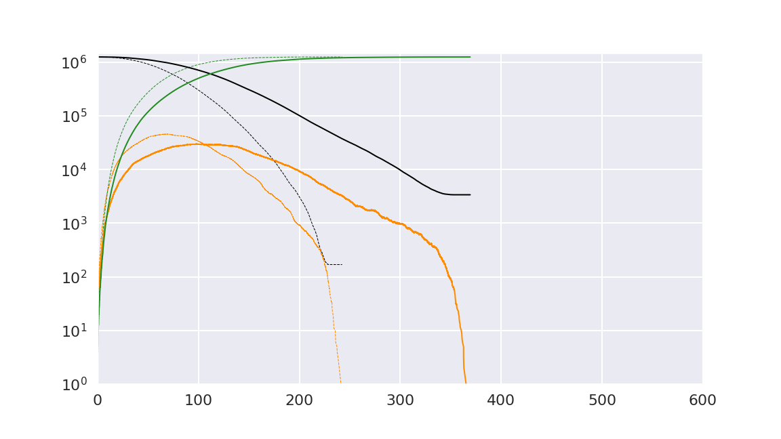
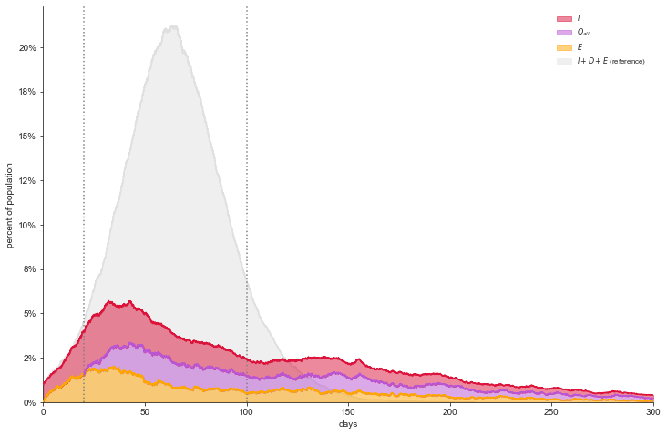
Plan of Action
‹#›
Work Done
Work Done
Future Scope
Future Scope
Talks and Presentations
Network Generation and SEIR simulations
Understanding of TDA and UMAP
In-depth comparison of variations in SEIR plots
Network Generation Models: 1. Barabasi-Albert 2. T-SNE 3. KNN
No Lockdown
Lockdown
Recovered
Susceptible
Exposed
Infected

Slide 7
THANK YOU
‹#›

